Slide 1
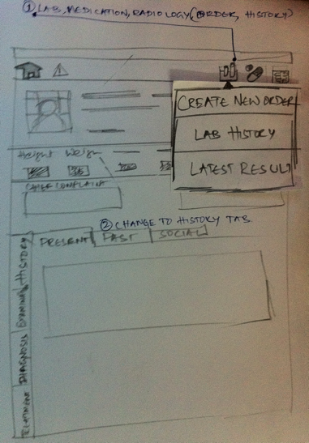
Lab Reports
LAB ICON on the top bar

Slide 2
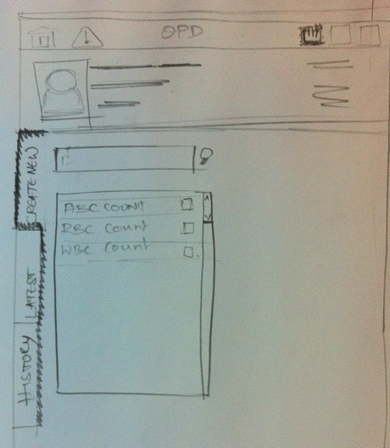
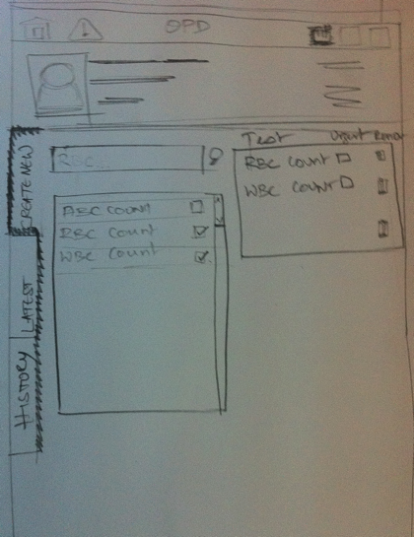
Create new lab order
Selected investigations are added here

Slide 3
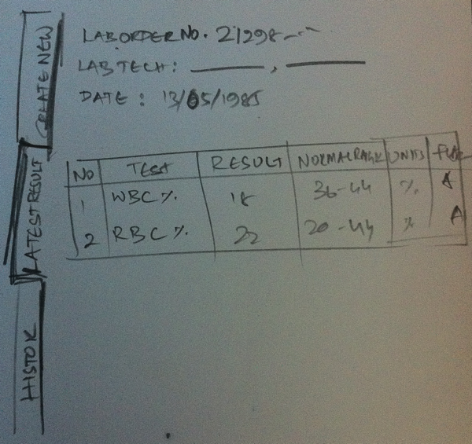
Latest Result Tab

Slide 4
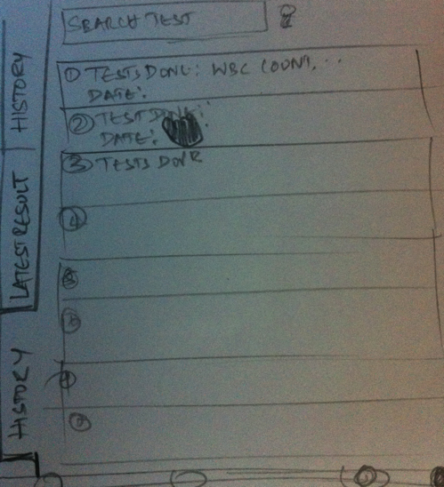
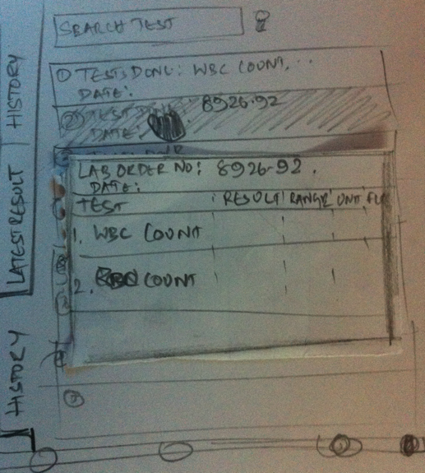
Lab History
Pop over with details of the test

Slide 5
History tab

Slide 6
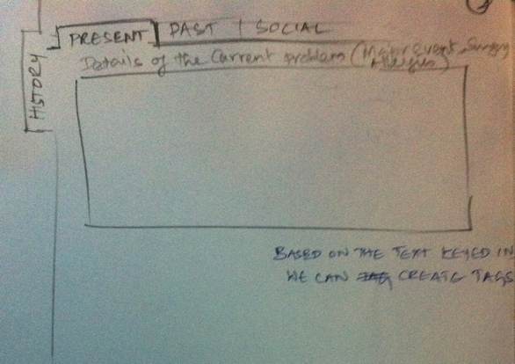
Wireframes – Present History
Auto save as user navigates to other tabs
Tap to edit once it is read-only

Slide 7
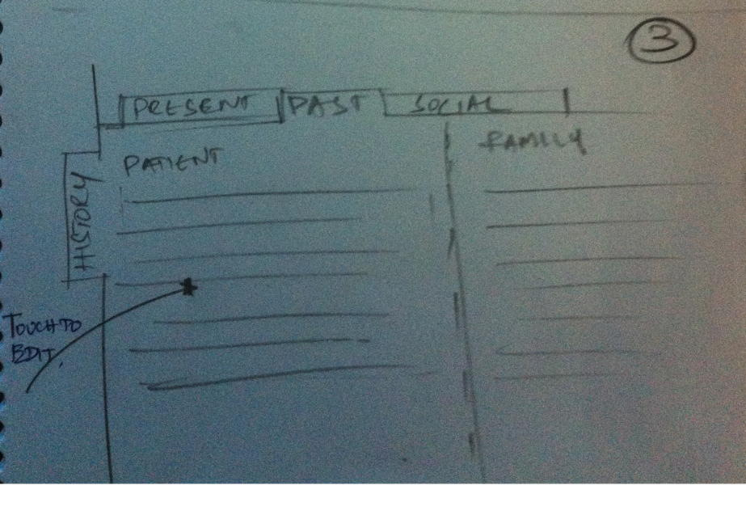
Wireframes – Past History

Slide 8
Wireframes – Social History
History
Present
Past
Social History
Alcohol
10 drinks per week
Since
June 2010
Enter notes
Tobacco
smoking
2 packs per day
Since
Jan 2000
Enter notes
Tobacco
oral
Heavy tobacco user
Since
Jan 2000
Enter notes
Notes
Enter notes

